Slide 1

D’s Nuts Chatbot
Link to github Repository: GitHub Repository
Links to trello board / project management tools: Trello Board
You MUST provide evidence showing how the problem has been decomposed, how the components have been developed and trialled, and of how they have been assembled and tested to create a final, working outcome.

Slide 2

Describe Your Client
Briefly describe the online store:
The online store is a starting business that will sell different types of high-quality organic nuts. Though they are just starting the business, the online store/company hopes to sell even more than just nuts, such as seeds, dried fruit, spices etc.
What do they sell?
They sell a range of nuts including peanuts, pistachio’s, macadamia, almonds, cashews, walnuts, pecans, hazelnuts, Brazil nuts, pine nuts, chestnuts and mixed nuts (all nuts mixed together).
Who is the target market?
The target market are for people who are enthusiastic about cooking, baking, or simply eating – regardless of what age you are.

Slide 3

Implication 1 - Privacy
Describe the implication:
The privacy implication refers to the integrity, confidentiality and availability of data/information. It is the protection of personal data from those who do not wish or consent for others to access it and the availability of individuals to determine who can access their personal information.

Slide 4

Implication 1 - Privacy
Explain why it needs to be considered:
This implication needs to be considered because many people wouldn’t want others to have access to their personal information. It is important that consumers feel safe when giving their information so they can protect their identity from risks of theft.

Slide 5

Implication 1 - Privacy
Explain how you plan to address the implication:
I plan to address this implication by making sure that, at the end of each order, I wipe out all the personal information that is given by the customer. This includes any phone numbers names, or home addresses. This way, no one will have any access to their personal information, and it keeps their identity safe.

Slide 6

Implication 2 – Usability (Error Recovery)
Describe the implication:
This implication (error recovery) is the ability of the compiler to resume parsing of a program after deleting such errors while the compilation. When any errors are entered into the program, it can easily recover when if the customer enters any invalid details.

Slide 7

Implication 2 – Usability (Error Recovery)
Explain why it needs to be considered:
This implication needs to be considered to make sure that the customer can move on to the next stage if they make an error; whether it was accidental or a mistake. Customers will know that something has gone wrong and, thus, will prevent any problems in the future if they make an error in their responses/answers. Otherwise, the program could lead to failure and stop responding, making the user frustrated.

Slide 8

Implication 2 – Usability (Error Recovery)
Explain how you plan to address the implication:
I plan to address this implication by including good error messages that are easy to understand, with constructive and clear advice on how they can improve their input. This will allow customers to understand what made their answer invalid (they can easily understand what is going on).

Slide 9

Implication 3 - Functionality
Describe the implication:
Functionality is the quality of my program and to serve the suited purpose well. It involves ensuring the program works as expected. It should work for expected, boundary, and unexpected cases. For example, my program asks how many items the user wants. It needs to work for a ‘sensible’ answer like 2 and it should also accept 1 (low valid) and it should not crash if users put in 0 (too low), text or a decimal.

Slide 10

Implication 3 - Functionality
Explain why it needs to be considered:
This implication needs to be considered because it ensures that my program performs as it should. In doing so, it helps users meet their goals and needs effectively. If the program crashes or gives incorrect output, user will become frustrated. Programs that don’t work correctly are of limited use and in real life, if a program does not function it could cause harm and/or damage the reputation if the developer.

Slide 11

Implication 3 - Functionality
Explain how you plan to address the implication:
I plan to address this implication by doing functionality testing throughout the development of my program; I will do this by testing the bot from a customer’s point of view, or by getting a family and/or friend to test it. This includes testing each component of the program individually as well as testing the whole (main) program as a whole.

Slide 12
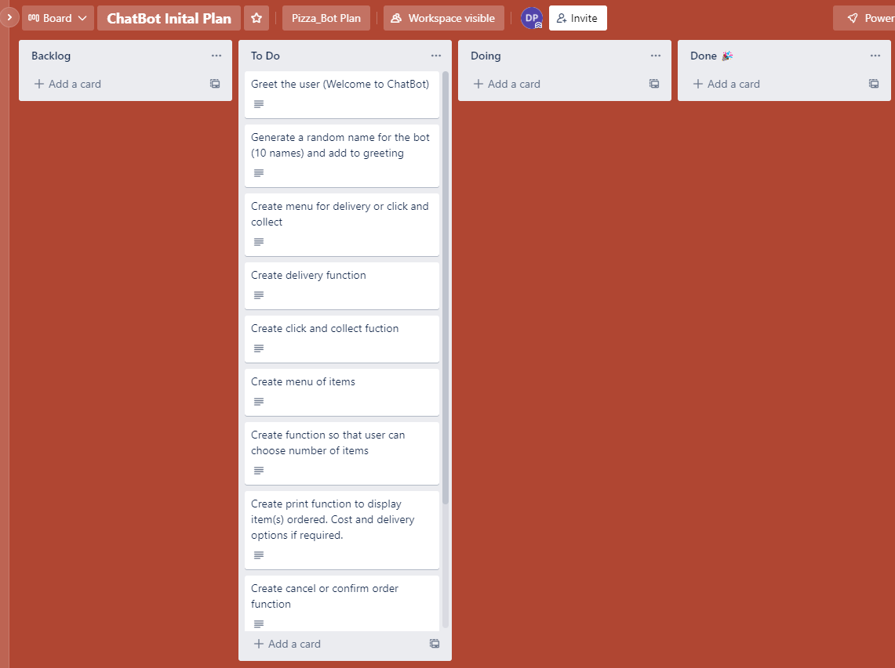
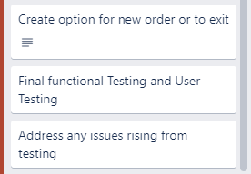
Decomposition
Notes:
Paste screenshots of your initial Trello board / task decomposition on this slide. If you have a long list, you might need to break it up into several columns. Delete this instruction when you are done.

Slide 13
Component Section

Slide 14
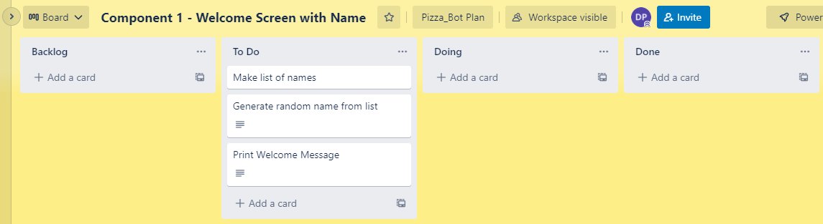
Component 1 (Trello screenshot)

Slide 15
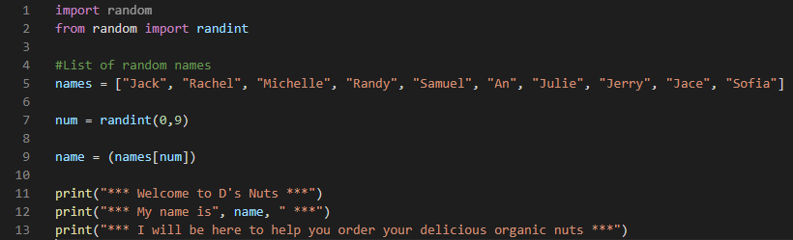

Component 1 - Test Plan (and screenshot)
Test Case | Expected Values
Run program | Prints welcome message with random name from list of names – runs correctly

Slide 16
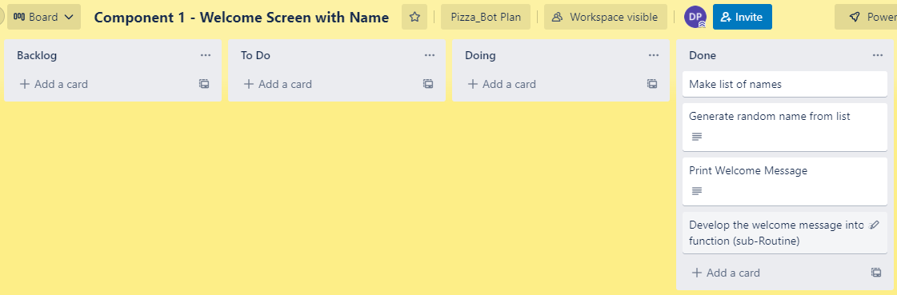
Component 1 Version 2 (Trello screenshot)

Slide 17
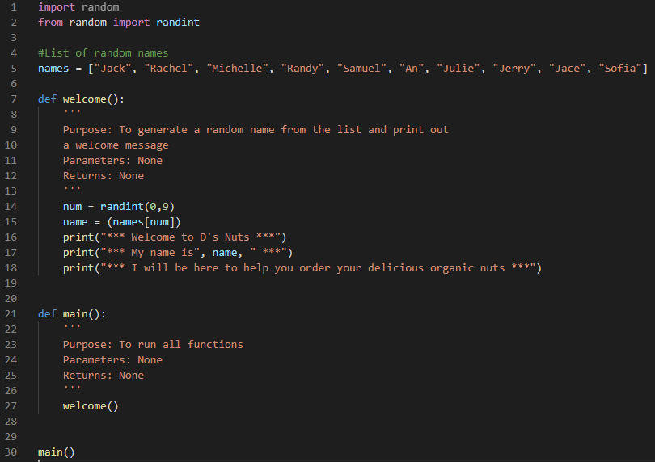
Component 1 Version 2 - Test Plan
Test Case | Expected Values
Run program | Prints welcome message with random name from list of names – runs correctly

Slide 18
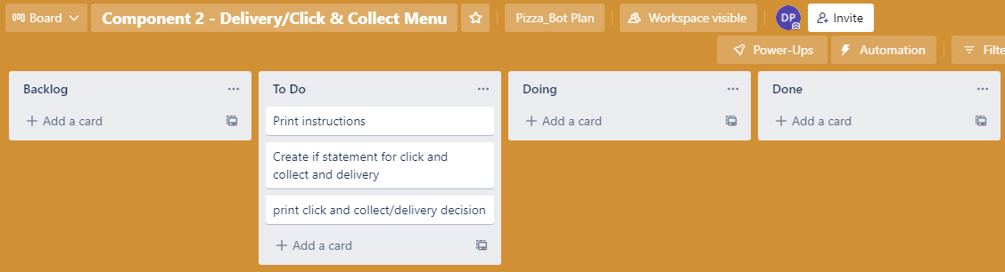
Component 2 Version 1 (Trello screenshot)

Slide 19
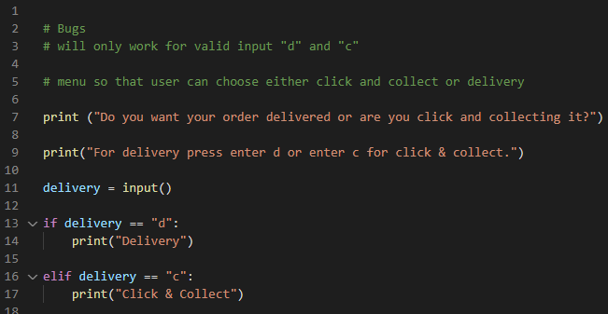

Component 2 Version 1 - Test Plan
Test Case | Expected Values
Run Program | Enter d program prints delivery Enter c program prints click & collect Enter invalid program stops

Slide 20
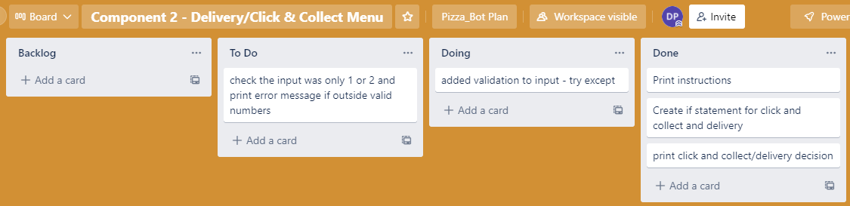
Component 2 Version 2 (Trello screenshot)

Slide 21
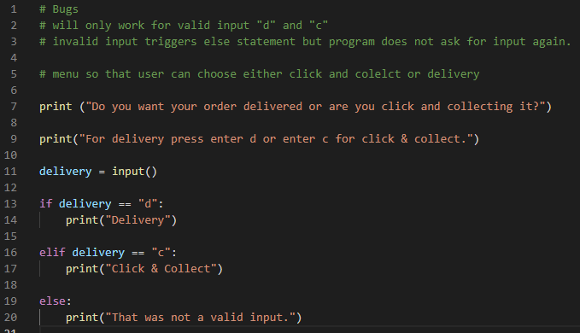

Component 2 Version 2 - Test Plan
Test Case | Expected Values
Run Program | Enter d program prints delivery Enter c program prints click & collect Enter g program prints “not valid”

Slide 22
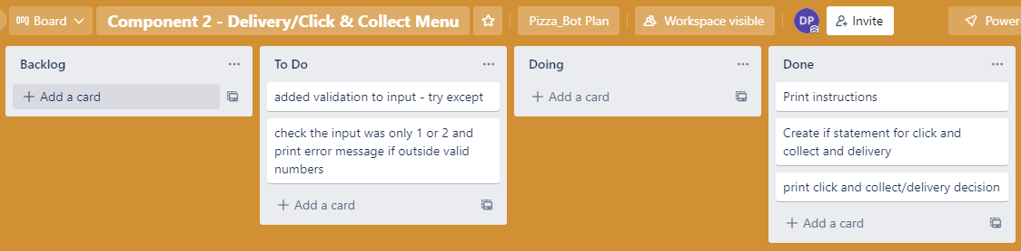
Component 2 Version 3 (Trello screenshot)

Slide 23
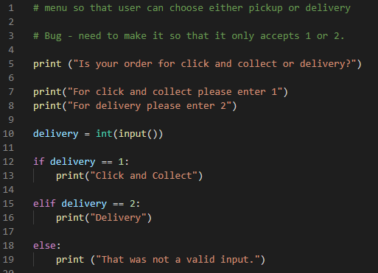

Component 2 Version 3 - Test Plan
Test Case | Expected Values
Run Program | Enter d program prints delivery Enter c program prints click & collect Enter invalid program displays value error

Slide 24

Component 2 Version 4 (Trello screenshot)

Slide 25
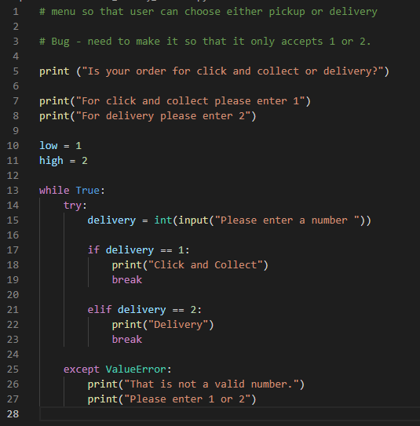
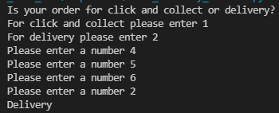
Component 2 Version 4 - Test Plan
Test Case | Expected Values
Run Program | Enter 1 program prints pickup. Enter 2 program prints delivery. Enter invalid prints error message. Enter no. other than 1 or 2 does not work

Slide 26
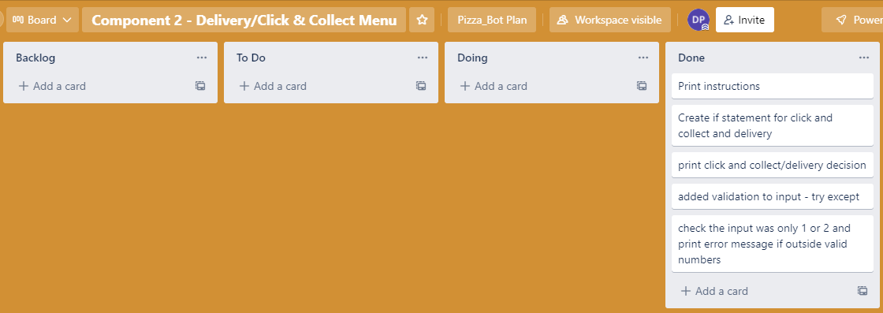
Component 2 Version 5 (Trello screenshot)

Slide 27
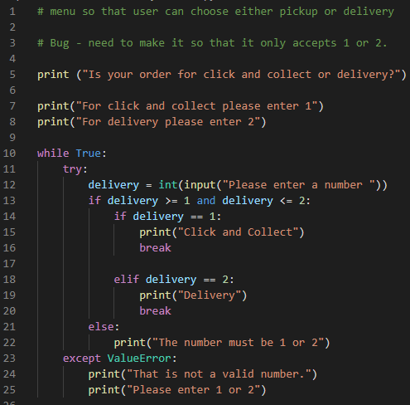
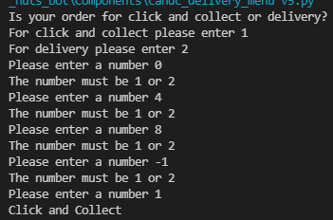
Component 2 Version 5 - Test Plan
Test Case | Expected Values
Run Program | Enter 1 program prints pickup. Enter 2 program prints delivery. Enter invalid entry - error message asks for input again. Enter no. other than 1 or 2 – error messages asks for entry again

Slide 28
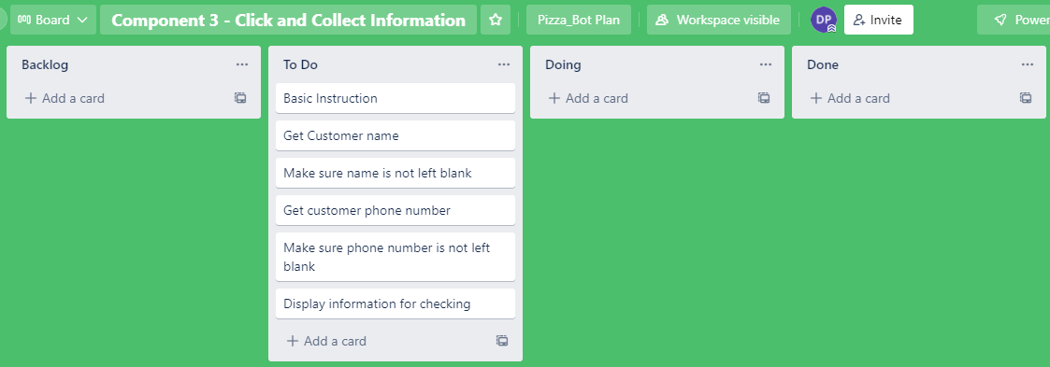
Component 3 Click & Collect info Version 1 (Trello screenshot)

Slide 29
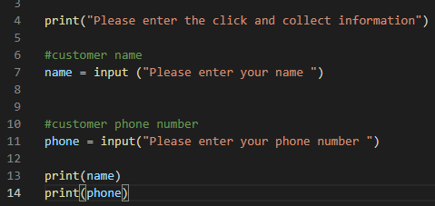
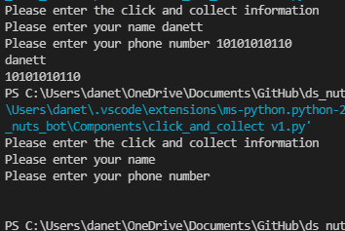
Component 3 Version 1 - Test Plan
Test Case | Expected Values
Input name Input phone number Left input blank | Printed name correctly Printed phone number correctly Accept blank and printed blank input

Slide 30
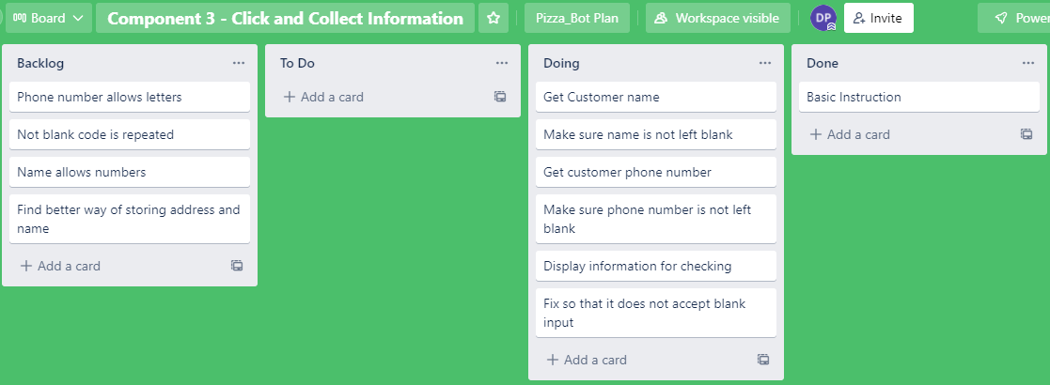
Component 3 Version 2 (Trello screenshot)

Slide 31
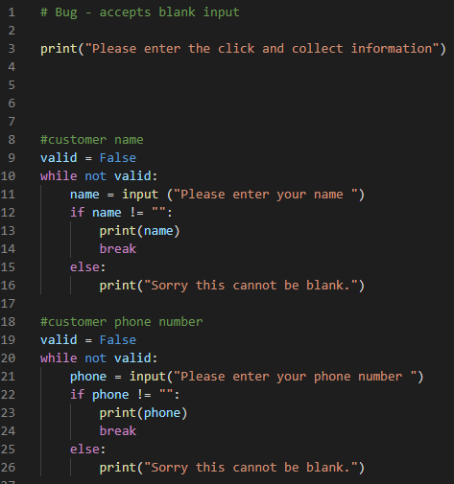
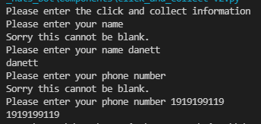
Component 3 Version 2 - Test Plan
Test Case | Expected Values
Input name Input phone number Left input blank | Printed name correctly Printed phone number correctly Prints “Sorry this cannot be blank” – goes back to input

Slide 32
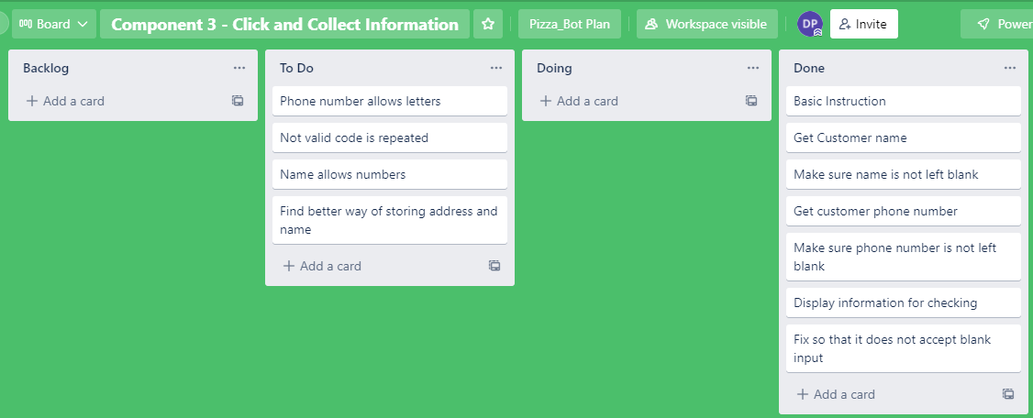
Component 3 Version 3 (Trello screenshot)

Slide 33
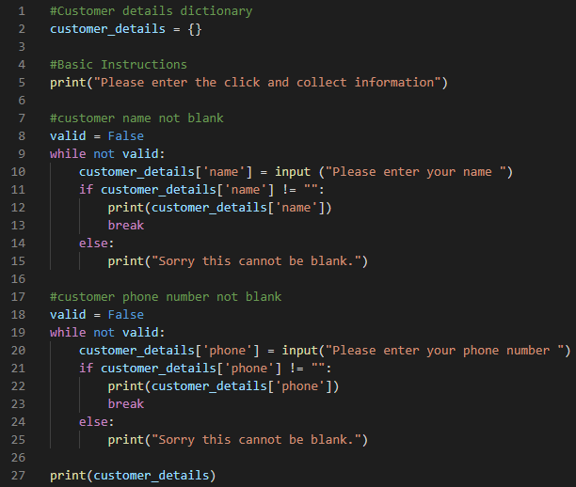
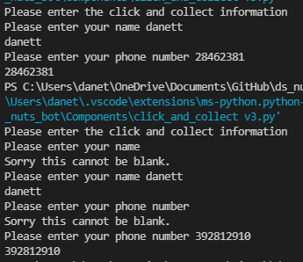
Component 3 Version 3 - Test Plan
Test Case | Expected Values
Input name Input phone number Left input blank | Printed name correctly Printed phone number correctly Prints “Sorry this cannot be blank” – goes back to input

Slide 34
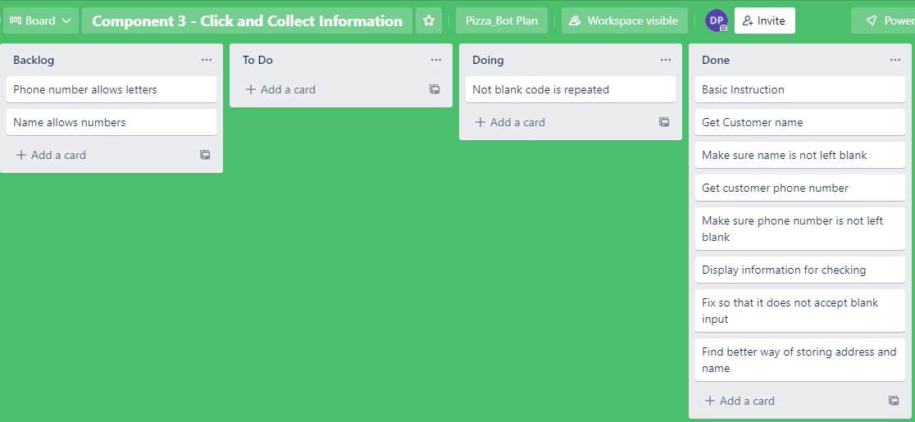
Component 3 Version 4 (Trello screenshot)

Slide 35
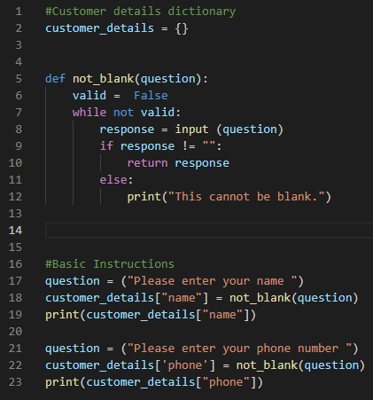
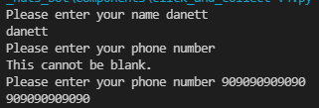
Component 3 Version 4 - Test Plan
Test Case | Expected Values
Input name Input phone number Left input blank | Printed name correctly Printed phone number correctly Prints “Sorry this cannot be blank” – goes back to input

Slide 36
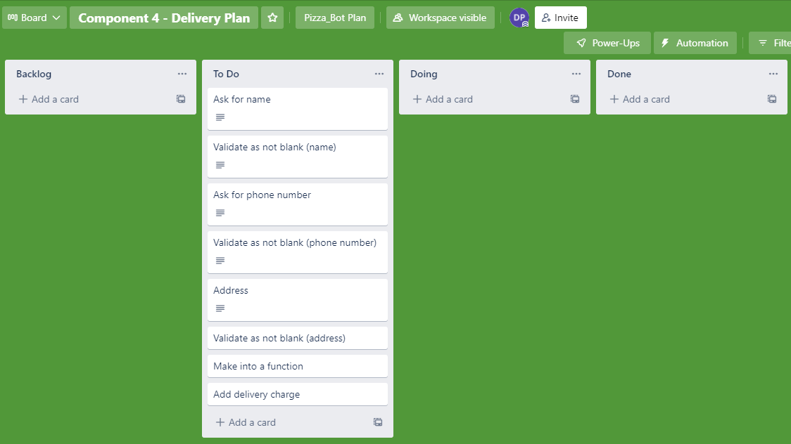
Component 4 Version 1 (Trello screenshot)

Slide 37

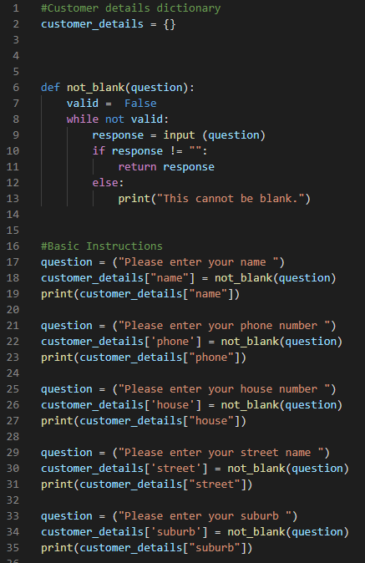
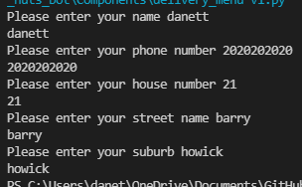
Component 4 Version 1 - Test Plan
Test Case | Expected Values
Input name Input phone number Input house number Street name Suburb name | Printed name correctly Printed phone number correctly Accept blank and printed blank input Printed street name Printed suburb name

Slide 38
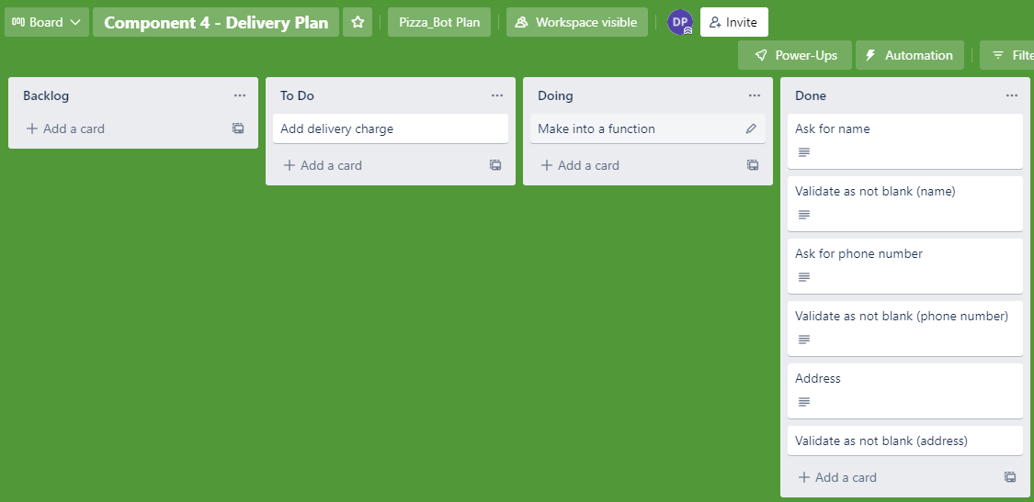
Component 4 Version 2 (Trello screenshot)

Slide 39
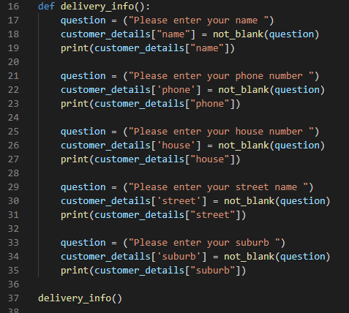
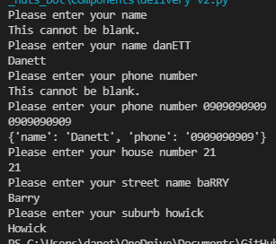
Component 4 Version 2 - Test Plan
Test Case | Expected Values
Input name Input phone number Input house number Street name Suburb name Left input blank | Printed name correctly Printed phone number correctly Printed house number Printed street name Printed suburb name Asked for input again

Slide 40
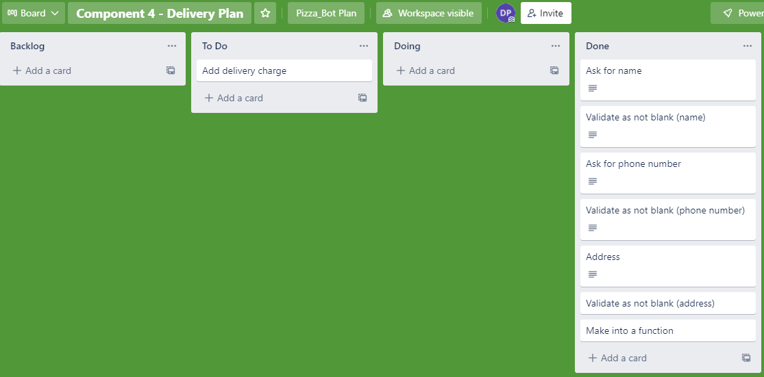
Component 4 Version 2 (Trello screenshot – integrated into main)

Slide 41
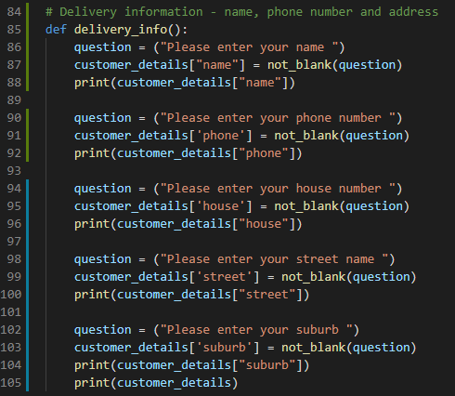
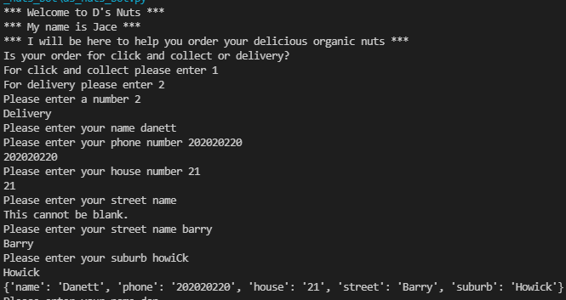
Component 4 Version 2 - Test Plan (integrated into main)
Test Case | Expected Values
Input name Input phone number Input house number Street name Suburb name Left input blank | Printed name correctly Printed phone number correctly Printed house number Printed street name Printed suburb name Asked for input again

Slide 42

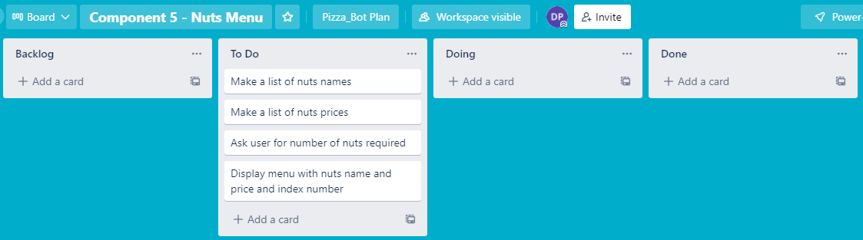
Component 5 Version 1 – Nuts Menu (Trello screenshot)

Slide 43

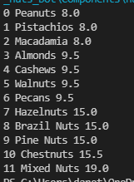
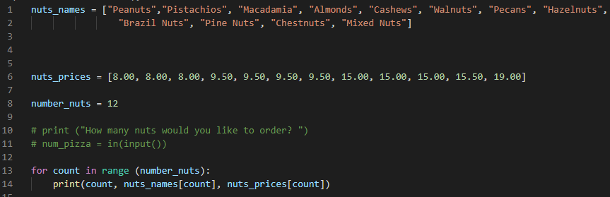
Component 5 Version 1 - Test Plan
Test Case | Expected Values
Run File | Printed list with index number, nuts and prices

Slide 44
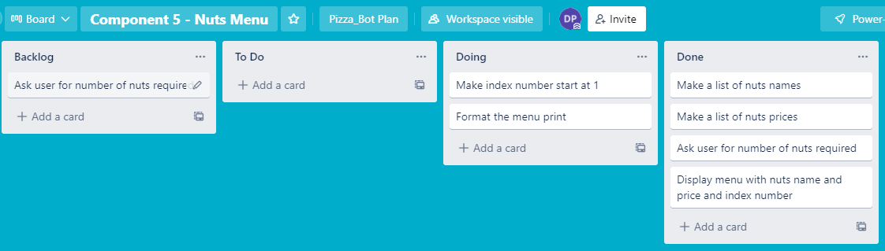
Component 5 Version 2 - (Trello screenshot)

Slide 45
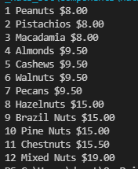
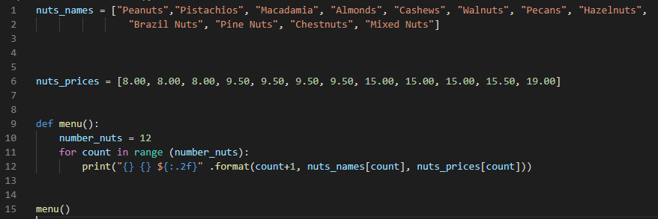
Component 5 Version 2 - Test Plan
Test Case | Expected Values
Run File | Printed a list with index number, pizzas and prices with price formatted to 2 decimal places and dollar sign. Menu starts at 1.

Slide 46
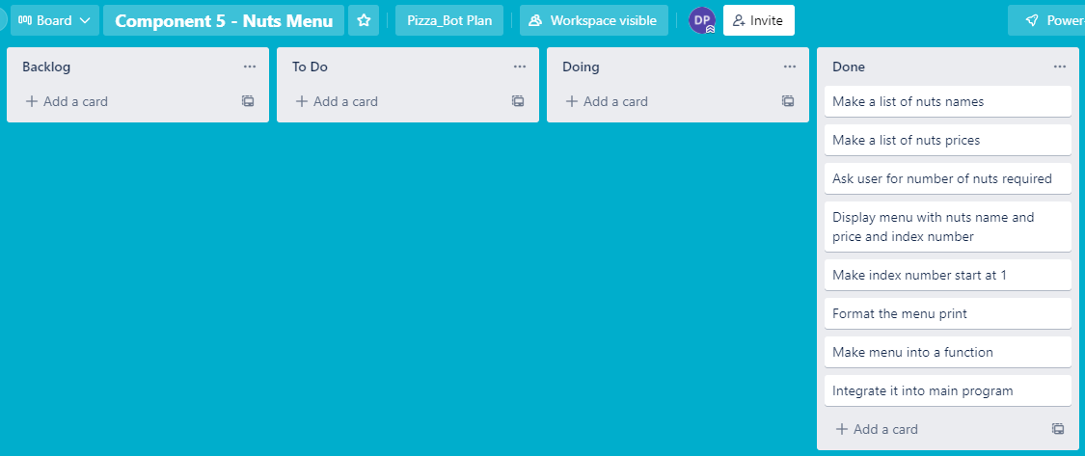
Component 5 Version 3 - (Trello screenshot – integrated into main app)

Slide 47
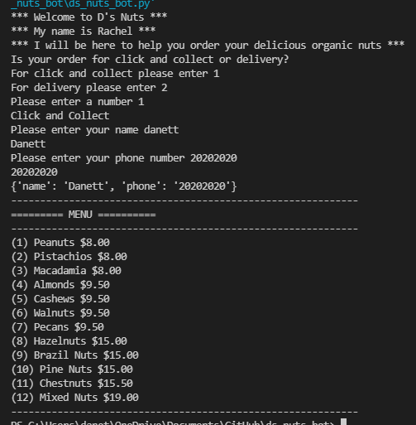
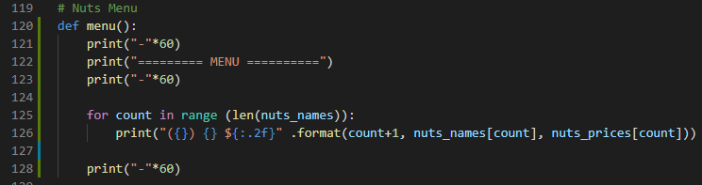
Component 5 Version 3 - Test Plan (integrated into main app)
Test Case | Expected Values
Run File | Printed a list with index number, pizzas and prices with price formatted to 2 decimal places and dollar sign. Menu starts at 1.

Slide 48

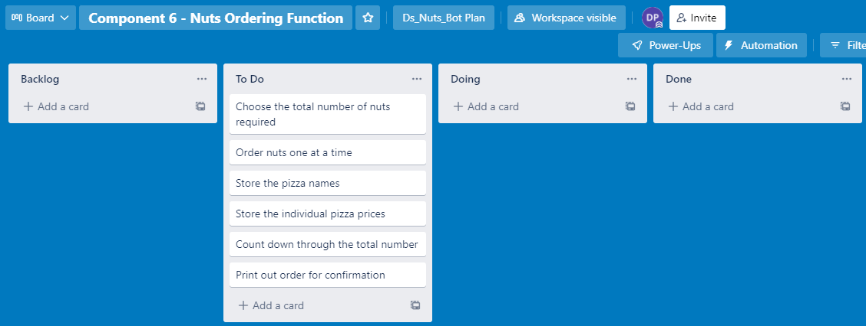
Component 6 Version 1 (Trello screenshot)

Slide 49

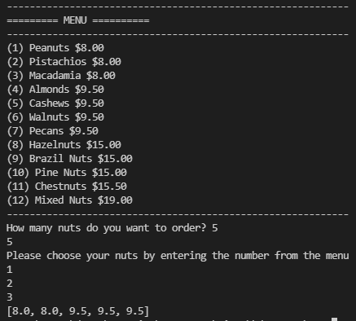
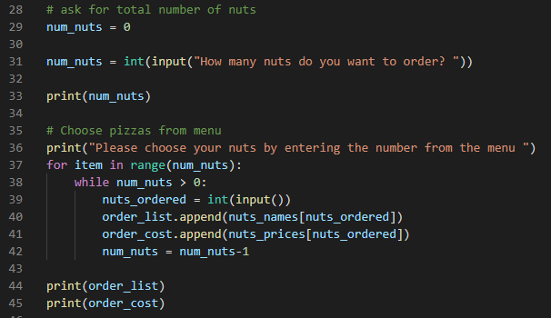

Component 6 Version 1 - Test Plan
Test Case | Expected Values
Enter 5 pizzas Entered ‘cat’ | Stepped through the menu choice 5 times Program broke

Slide 50

Component 6 Version 2 (Trello screenshot)

Slide 51


Component 6 Version 2 - Test Plan
Test Case | Expected Values
W % Space 0 13 12 | Not a valid number Not a valid number Not a valid number Must be between 1 and 12 Must be between 1 and 12 Accepted continues to order

Slide 52

Component 6 Version 3 (Trello screenshot – integrated into main app)

Slide 53


Component 6 Version 3 - Test Plan (integrated into main app)
Test Case | Expected Values
W % Space 0 13 2000 12 | Not a valid number Not a valid number Not a valid number Must be between 1 and 12 Must be between 1 and 12 Must be between 1 and 12 Accepted continues to order

Slide 54

Component 7 – Print Order Version 1 (Trello screenshot)

Slide 55


Component 7 Version 1 - Test Plan
Test Case | Expected Values
Ran test with data | Prints correctly

Slide 56

Component 7 Version 2 (Trello screenshot)

Slide 57


Component 7 Version 2 - Test Plan
Test Case | Expected Values
Ran test with data | Prints details, but requires more formatting

Slide 58
Component 7 Version 3 (Trello screenshot)

Slide 59


Component 7 Version 3 - Test Plan
Test Case | Expected Values
Ran test with data | Prints details (customer details are more formatted and easier to read)

Slide 60

Component 7 Version 4 (Trello screenshot)

Slide 61


Component 7 Version 4 - Test Plan
Test Case | Expected Values
Ran test with data | Function prints details on separate page with formatting – total cost added.

Slide 62

Component 7 Version 5 (Trello screenshot)

Slide 63



Component 7 Version 5 - Test Plan
Test Case | Expected Values
Choose Click and Collect Choose Delivery ***Delivery charge (less than 5) not applied | Click and collect worked – printed name and phone Delivery worked – printed name, phone and address

Slide 64

Component 7 Version 6 (Trello screenshot)

Slide 65
Component 7 Version 6 - Test Plan
ADD DELIVERY CHARGE
Test Case | Expected Values
Choose Click and Collect Choose Delivery | Click and collect worked – printed name and phone Delivery worked – printed name, phone, added $9 delivery charge to less than 5 items, but free if 5 or more items ordered.

Slide 66

Component 8 Version 1 (Trello screenshot)

Slide 67


Component 8 Version 1 - Test Plan
Test Case | Expected Values
Entered 1 Choose Confirm Entered 2 Choose Cancel Entered 4 Entered s | Confirm worked – printed “confirm” Cancel worked – printed “cancel” Printed “Please enter 1 or 2” Printed “please enter a valid number”

Slide 68

Component 8 Version 2 (Trello screenshot)

Slide 69


Component 8 Version 2 - Test Plan (integrated into main app)
Test Case | Expected Values
Entered 1 Choose Confirm Entered 2 Choose Cancel Entered 4 Entered s | Confirm worked – printed “confirm” Cancel worked – printed “cancel” Printed “Please enter 1 or 2” Printed “please enter a valid number”

Slide 70

Component 9 New Order or Exit Version 1 (Trello screenshot)

Slide 71


Component 9 Version 1 - Test Plan
Test Case | Expected Values
Entered 1 Choose new order Entered 2 Choose exit Entered 4 Entered s | Confirm worked – printed “new order” Cancel worked – printed “Exit” Printed “Please enter 1 or 2” Printed “please enter a valid number”

Slide 72

Component 9 Version 2 (Trello screenshot)

Slide 73


Component 9 Version 2 - Test Plan (integrated)
Test Case | Expected Values
Entered 1 Choose new order Entered 2 Choose exit Data remains in the order – cost and details list | Confirm worked – printed “new order” Cancel worked – printed “Exit” “ Data cleared from the list

Slide 74

Testing Section

Slide 75


Functional Testing – Component 2 (Order Type)
Tested to see the outcome of expected input (1 or 2), boundaries (0 and 3) and invalid (<blank> and special character, %) of choosing an order type – Click and collect or Delivery.

Slide 76

Functional Testing – Component 3 (Click & Collect Information)
Tested to see the outcome of expected input (1 or 2), boundaries (0 and 3) and invalid (<blank>, ‘cat’ and special character, &) of the input for Click and Collect information.

Slide 77

Functional Testing – Component 4 (Order Type 2 - Delivery Information, Part 1)
Tested to see the outcome of expected input (1 or 2), boundaries (0 and 3) and invalid (<blank> and special character, %) of the input for Delivery information.

Slide 78


Functional Testing – Component 4 (Order Type 2 - Delivery Information, Part 2)

Slide 79
Functional Testing – Component 5 (Nuts Menu)

Slide 80


Functional Testing – Component 6 (Nuts Ordering Function, Part 1)
Tested to see the outcome of expected input (1 or 12), boundaries (0 and 13) and invalid (<blank> and special character, %) of the input for ordering (choosing) how many nuts and which types.

Slide 81
Functional Testing – Component 7 (Order Print Function)
Tested to see the outcome of expected input (1 or 2), boundaries (0 and 3) and invalid (<blank> and special character, %) of the input for ordering (choosing) how many nuts and which types.

Slide 82

Functional Testing – Component 8 (Confirm or Cancel Order Function)
Tested to see the outcome of expected input (1 or 2), boundaries (0 and 3) and invalid (<blank>, ‘cat’ and special character, %) of the input for ordering (choosing) how many nuts and which types.

Slide 83

Functional Testing – Component 9 (Start New Order or Exit)
Tested to see the outcome of expected input (1 or 2), boundaries (0 and 3) and invalid (<blank>, ‘cat’ and special character, %) of the input for ordering (choosing) how many nuts and which types.

Slide 84


Functional Testing (List) of Found Bugs

Slide 85
Functional Testing – Bugs fixed

Slide 86
Using evidence of testing show how you refined your program (duplicate slides) DELETE THIS SLIDE.

Slide 87
Refining Program

Slide 88
Created string_checking Function
This is to avoid integer inputs from going through the program – this function only allows letters to be input in components such as name, street name, and suburb. Used to fix bugs with “Accepts integers” or “Accepts special characters”.

Slide 89
User Testing (Screenshot and show feedback from a range of users/testers)

Slide 90
Using evidence of user feedback show how you refined your program (duplicate slides)

Slide 91
Version Control Section Section
Duplicate Slides if required – Show screenshot of GitHub commits and comments

Slide 92
Version Control Evidence
Your version control evidence should go here. This could be in the form of annotated screenshots which show you you managed this process or you could make a brief screencast explaining how you implemented version control.
Notes:
Your version control evidence should go here. This could be in the form of annotated screenshots which show you you managed this process or you could make a brief screencast explaining how you implemented version control.

Slide 93
Python Code Coventions
Show screenshot of PEP8 testing both before and after.

Slide 94
Python convention testing (PEP8)
Screenshot of errors
Notes:
Your version control evidence should go here. This could be in the form of annotated screenshots which show you you managed this process or you could make a brief screencast explaining how you implemented version control.

Slide 95
Python convention testing (PEP8)
Screenshot after errors fixed
Notes:
Your version control evidence should go here. This could be in the form of annotated screenshots which show you you managed this process or you could make a brief screencast explaining how you implemented version control.

Slide 96
Discusses how the information from planning, testing and trialling of components assisted in the development of a high-quality outcome
Notes:
Discusses how the information from planning, testing and trialling of components assisted in the development of a high-quality outcome

